Slide 1
Contemporary Moral Problems
M-F12:00-1:00SAV 264
Instructor: Benjamin Hole
Office Hours: everyday after class
Email: bvhole@uw.edu

Slide 2
Agenda
Review Mill
Clicker Quiz
Kant
Context & Good Will
Begin the CI
Tomorrow: universal law and humanity formulations of the CI

Slide 3
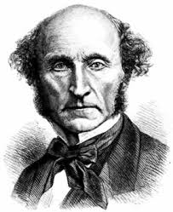
Mill’s Hedonistic Utilitarianism
Review
Theory of the Right
Theory of the Good
Review what each of these are for Mill and some of the biggest objections to each.

Slide 4

Please set your Turning Technology Clicker to channel 41
Press “Ch”, then “41”, then “Ch”

Slide 5
According to Kant, moral laws are:
necessary and apply to all rational beings.
contingent and apply only to human beings.
culturally relative.
grounded in God’s commands.
all the above
none of the above

Slide 6
According to Kant, the moral worth of an action depends on:
the moral character of the agent who performs it, e.g., whether the agent has sympathy or the right inclination.
the consequences of the action.
the maxim that is acted on.
all of the above.
none of the above.

Slide 7
Kant claims that the natural purpose of reason is to:
produce happiness.
produce pleasure.
produce knowledge.
produce a good will.
all of the above.
none of the above.

Slide 8
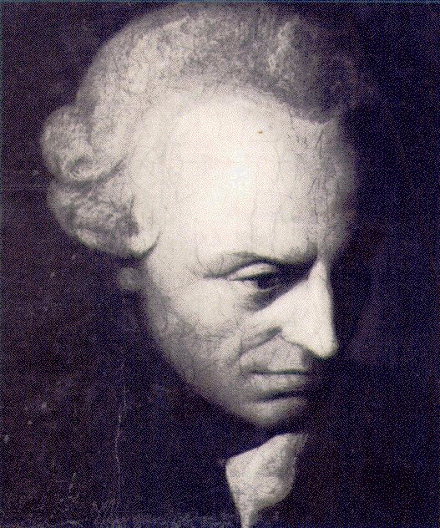
Immanuel Kant (1724-1804)
He’s technical and complex.
He’s enormously influential.
Timmons / Mappes
Velleman
O’Neil
One of the greatest philosophers in history, with major contributions in epistemology, metaphysics, ethics, the philosophy of religion, aesthetics, and many other areas.

Slide 9
Two Morally Charged Questions
What if everyone did that?
How would you like it if someone did that to you?
Both raise the issue of fairness, but neither provides a foolproof test of the morality of actions.

Slide 10
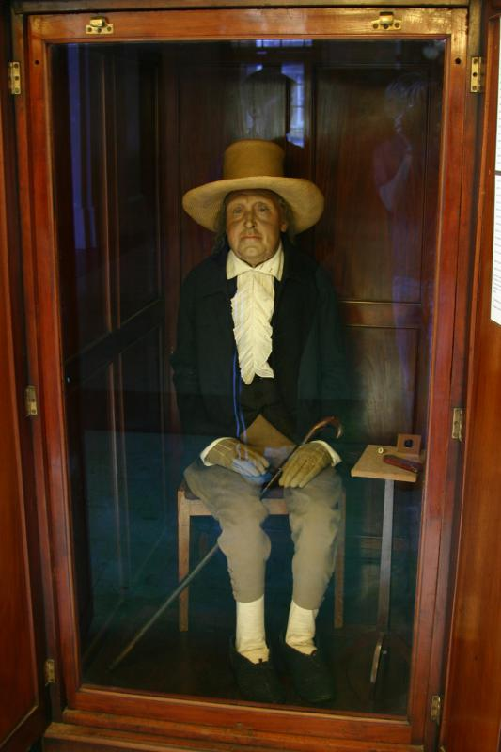
How does Kant compare to Bentham?
HETERONOMY
AUTONOMY

Slide 11
How does Kant compare to Bentham?
Bentham’s source of moral salience: sentience
Moral Claims:
empirical
knowable a posteriori
contingent
Kant’s source of moral salience: agency
Moral Claims:
non-empirical
knowable a priori
necessary

Slide 12

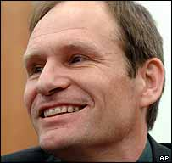
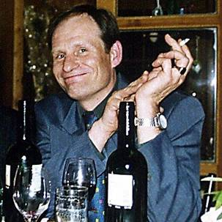

Heteronomy vs. Autonomy
http://www.guardian.co.uk/world/2003/dec/04/germany.lukeharding
http://www.youtube.com/watch?v=-ylE5NXR3I0

Slide 13
How does Kant compare to Bentham?
HETERONOMY
AUTONOMY

Slide 14

How does Kant compare to Bentham?
HETERONOMY
AUTONOMY

Slide 15
Kantian Autonomy
Strongly Agree
Agree
Somewhat Agree
Neutral
Somewhat Disagree
Disagree
Strongly Disagree

Slide 16
The Good Will
Kantian Ethics

Slide 17
The structure of Kantian Ethics
The Good
The Right
Good Will
The Categorical Imperative

Slide 18
Explicating the good will:
Kant’s Three Propositions
“to have moral worth an action must be done from duty”
“An action performed from duty does not have its moral worth in the purpose which is to be achieved through it but in the maxim by which it is determined.”
“Duty is the necessity of an action executed from respect for the law.”

Slide 19

The Sympathetic Shopkeeper
“Persons who help or benefit others because they have a spontaneous inclination toward sympathy (or benevolence or generosity) are, like the shopkeeper, doing what they want to do and not acting out of duty; thus their actions … have no real moral worth”

Slide 20
The Sympathetic Shopkeeper
“The person worthy of moral esteem is the one who has no desire or inclination at all to help anyone … but who helps others out of moral duty alone”

Slide 21
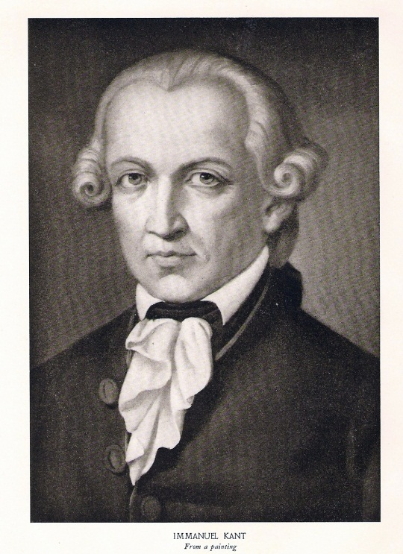
Moral Value
Maxim: “principle of volition” or reason for action.
Hypothetical Imperatives claim that a possible action is necessary as a means to the attainment of something one wants.
A Categorical Imperative represents an action as objectively necessary, without regard to a further end.

Slide 22
Comparison
Utilitarianism
Kantianism
Theory of value: pleasure is the only intrinsic good.
Right action: consequences are the sole determinate.
Motivation: the agent’s maxim is irrelevant to the action’s moral worth.
Theory of value: the good will is the only unconditional good.
Right action: consequences are irrelevant.
Motivation: the agent’s maxim is the sole determinant of moral worth.

Slide 23
The Universal Law Formulation of the Categorical Imperative
Kantian Ethics

Slide 24
CI: The Formula of Universal Law
“Act only according to that maxim by which you can at the same time will that it should become a universal law of nature.”
“An action is right if and only if one can (a) consistently conceive of everyone adopting and acting on the general policy of one’s action, and also (b) consistently will that everyone act on that maxim” (Timmons, 17).

Slide 25
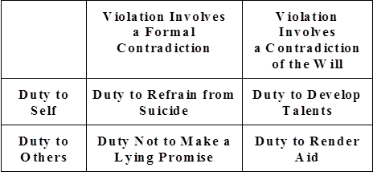
Kant’s Four Examples

